Slide 1
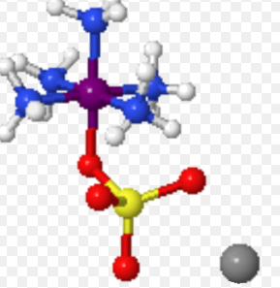
STRUCTURAL ISOMERISM IN COORDINATION COMOUNDS

Slide 6
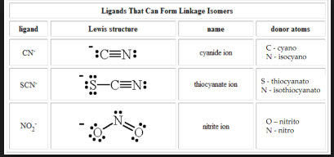

Slide 10
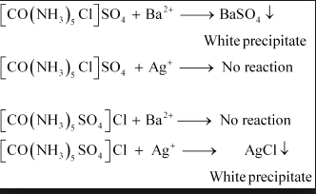

Slide 11
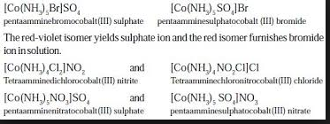

Slide 14
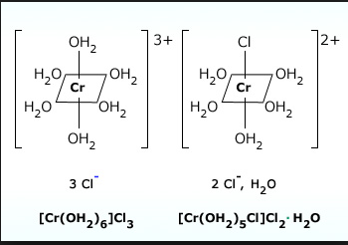

Slide 16
BONDING FEATURES OF COORDINATION COMPOUNDS
A coordination complex is one in which a central atom or ion is joined to one or more ligands (Latin ligare, to tie) through what is called a coordinatecovalent bond in which both of the bonding electrons are supplied by the ligand.

Slide 18
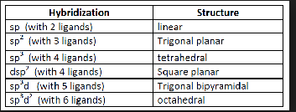

Slide 19
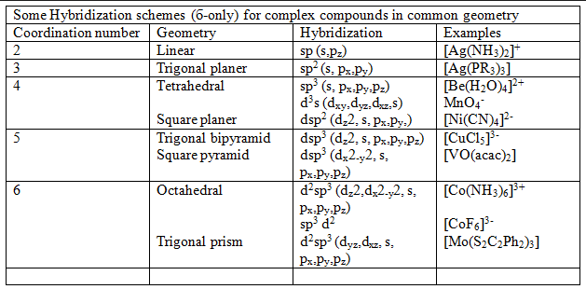

Slide 20
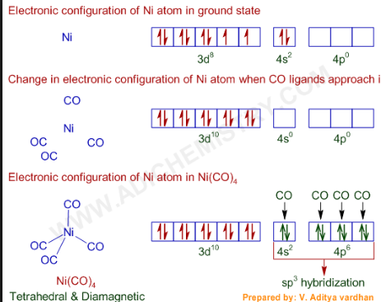

Slide 21
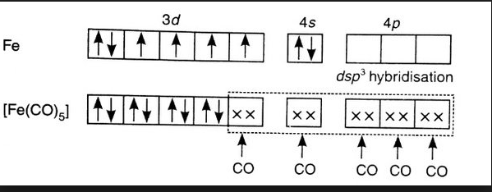
sp3d HYBRIDISATION

Slide 22
